Slide 1


PEOPLE ANALYTICS
for better business performance

Slide 2
People Analytics
What is it?
data-driven approach for Human Resource Management
Why?
Identify
Attract
Develop
Retain
How?
Building Statistical Models by
Analyzing patterns & causal relations
T
A
L
E
N
T
People analytics = Workforce analytics + HR analytics

Slide 3
Business Understanding
Helps an organization to...
to understand why best and most experienced employees leave prematurely
to predict which valuable employees will leave next
to find out what employees feel about their workplace

Slide 4
Goals
Perform Exploratory Data Analysis (EDA)
to find general behavior of Employees
Discover Insights
to identify valued employees & find factors contributing to attrition
Sentiment Analysis
using text mining approach of Natural Language Processing
Develop Statistical Models
Logistic Regression , Decision trees & Random forest to find best-fit
Deploy Best-Fit Model
to predict who will leave next

Slide 5
Data Preparation
Human Resource Analytics Data from Kaggle
10 Attributes / 14999 Rows
Numeric/Factors/Integers
Data Metrics such as Satisfaction level, Last Evaluation, Number of projects, Time Spent, etc.
Employee Reviews Data from Kaggle
Used 3 Attributes
Text Data/Comments/Opinions
Data Metrics such as Pros, Cons & Advice to Management
Clubbed these two datasets into one dataset

Slide 6
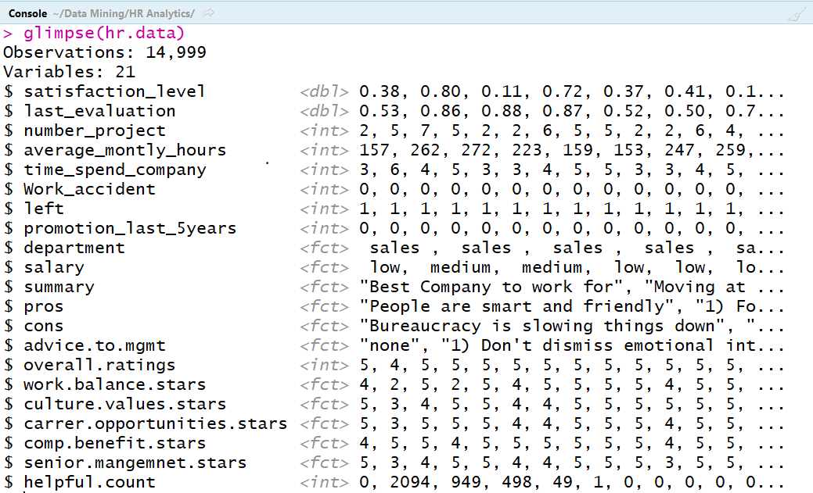
Glimpse of Dataset

Slide 7
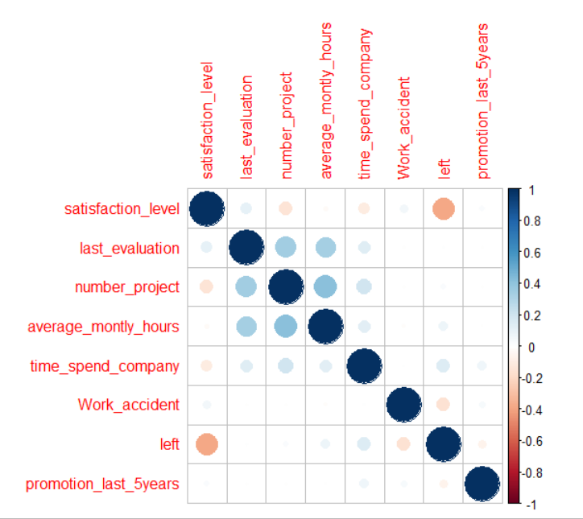
Correlation Matrix
Factors responsible for Attrition:
low satisfaction level
working hours
time spend in company
promotion within five years
Notes:
On average people who leave have a low satisfaction level, they work more and didn’t get promoted within the past five years.

Slide 8
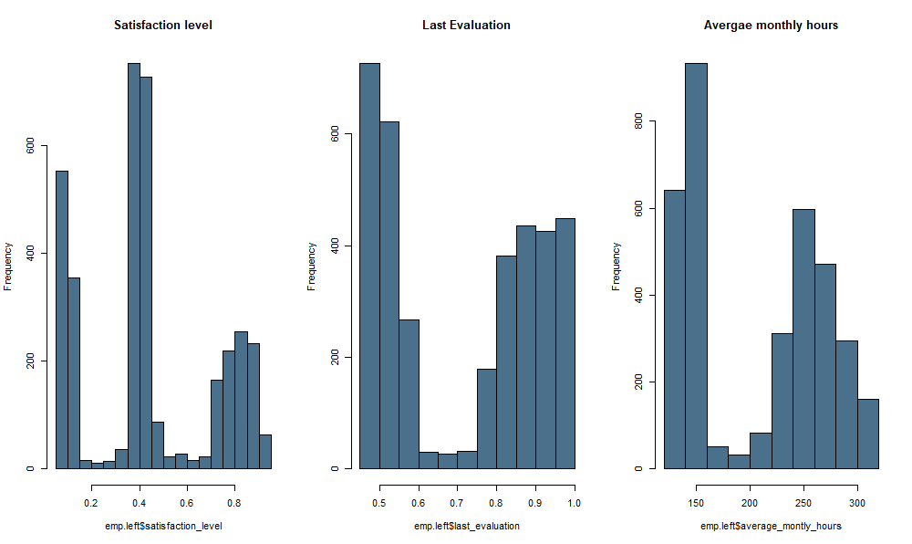
Satisfaction/Evaluation/Working Hours ~ Attrition
Low Satisfaction Level
Low & High Performers
Less & More
Working Hours

Slide 9
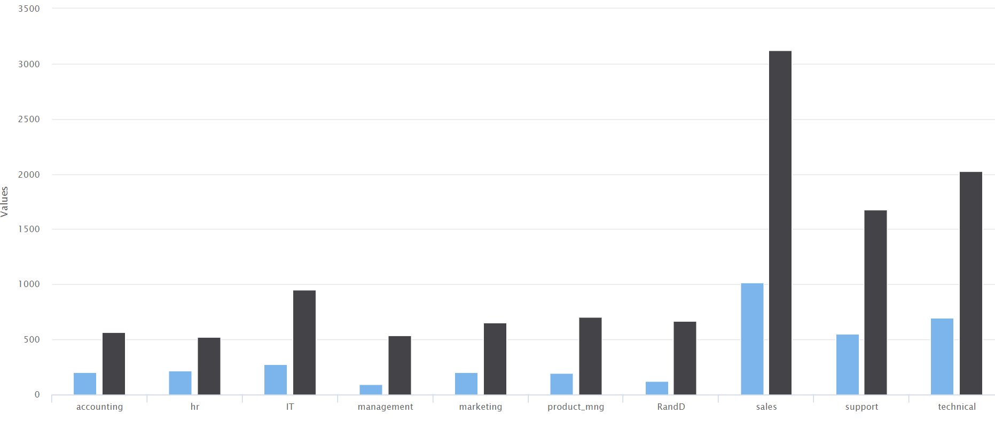
Attrition Rate vs Department
Maximum for Sales Department

Slide 10
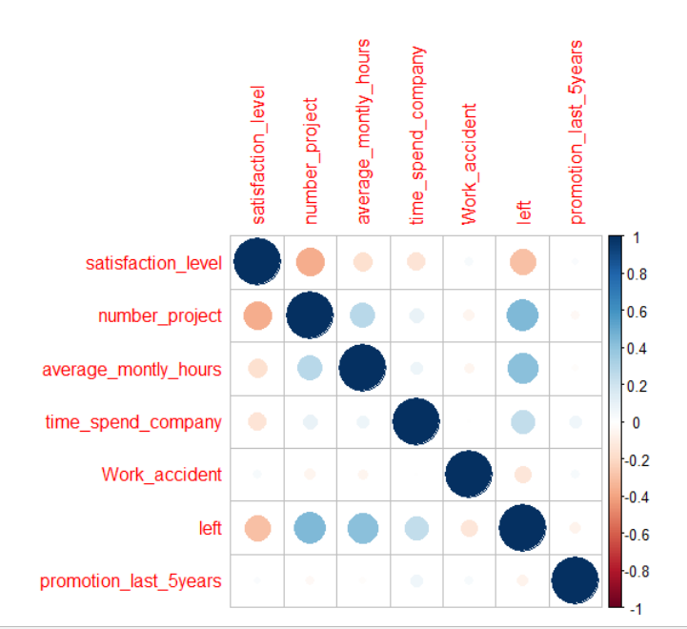
Good Employees
Correlation matrix
Criteria for good Employees
last_evaluation >= 0.70
time_spend_company >= 4
number_project > 5
Notes:
Here it’s much clearer. On average valuable employees that leave are not satisfayed, work on many projects, spend many hours in the company each month and aren’t promoted.

Slide 11
Experimental Model
Building Predictive Models using Regression, Classification
Numeric: Satisfaction, Performance, Projects, Work Accidents, Salary ...
Attrition Rate
Performance rate
Factors for job Satisfaction
Sentiment Analysis
Identifying Gaps
Recognitions
Classifying Resumes
Employee Data
Data Mining
Algorithms
(R, RStudio)
Text: Applications, Surveys, Feedback, Pros, Cons, Advice to Management ...
Text Mining using
Natural Language Processing

Slide 12
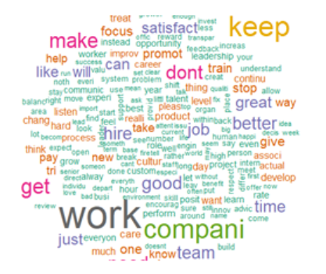
Employees Sentiment Analysis
Performed Text Mining to get Insights from Reviews of Employees
Text Extraction Process for Natural Language Processing:
Convert into Corpus
Lower Case
Remove Punctuation
Remove Stop Words
Stemming
Convert DTM to TDM
Notes:
Now lets find out what Employees feel about their workplace? With the help of natural language processing algorithm we performed text mining to gather employees sentiments for the workplace.

Slide 13


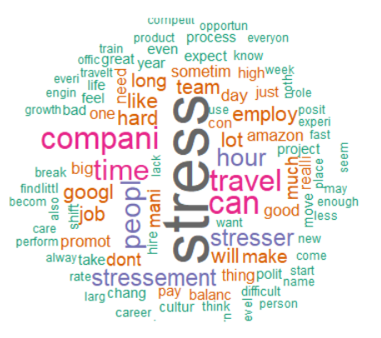
Word Cloud for Pros and Cons Reviews
Notes:
Pros wordcloud shows that benefits, pay, culture, great work and company are positive sentiments
While cons wordcloud show negative sentiments like stressful work, long working hours, and travel

Slide 14
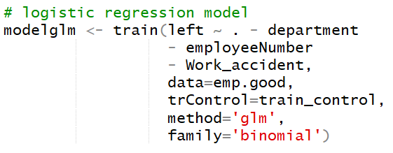
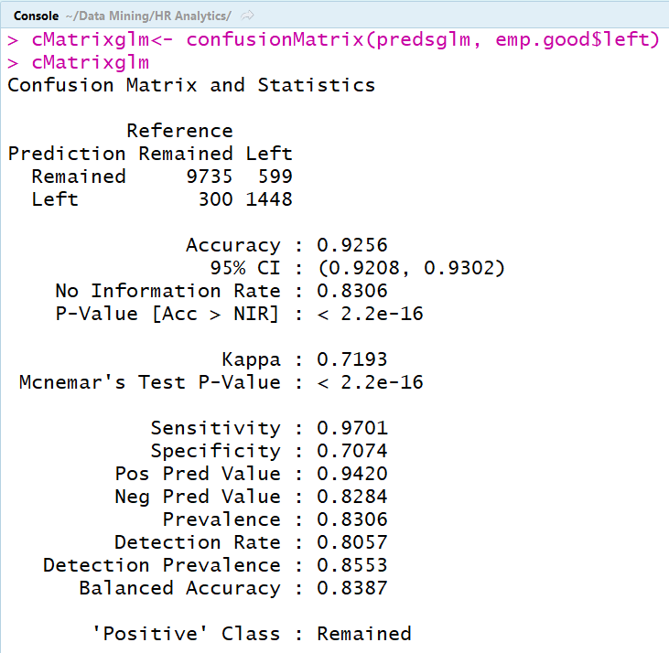
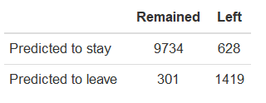
Logistic Regression
Confusion
Matrix
Training the Model
Predictions
92.5%
Accuracy
Notes:
LR> TRAIN> Predicted TP and FP. There are 1419 cases which were correctly predicted who left, while 9734 cases were correctly predicted to stay. From the confusion matrix we can see that this model has 92.5% accuracy.

Slide 15
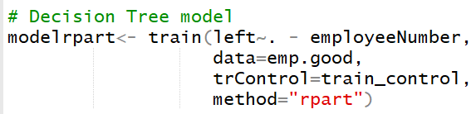
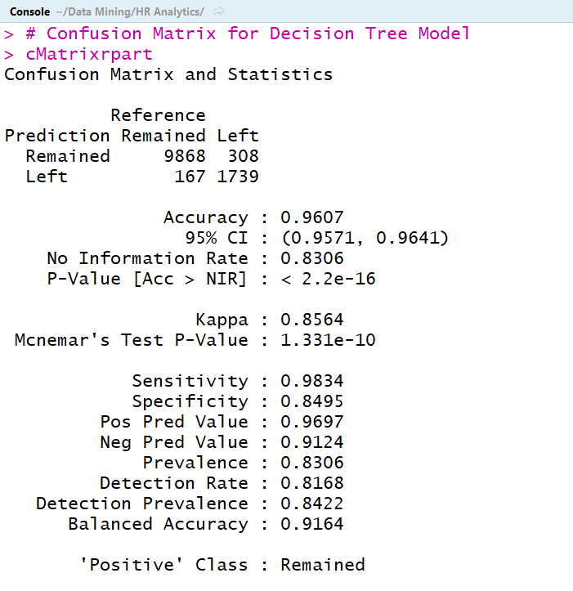
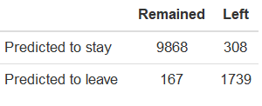
Decision Trees
Confusion
Matrix
Training the Model
Predictions
96%
Accuracy
Notes:
DT> TRAIN> Predicted TP and FP. There are 9868 cases which were correctly predicted who stay, while 1739 cases were correctly predicted to leave. From the confusion matrix we can see that this model has 96% accuracy.

Slide 16

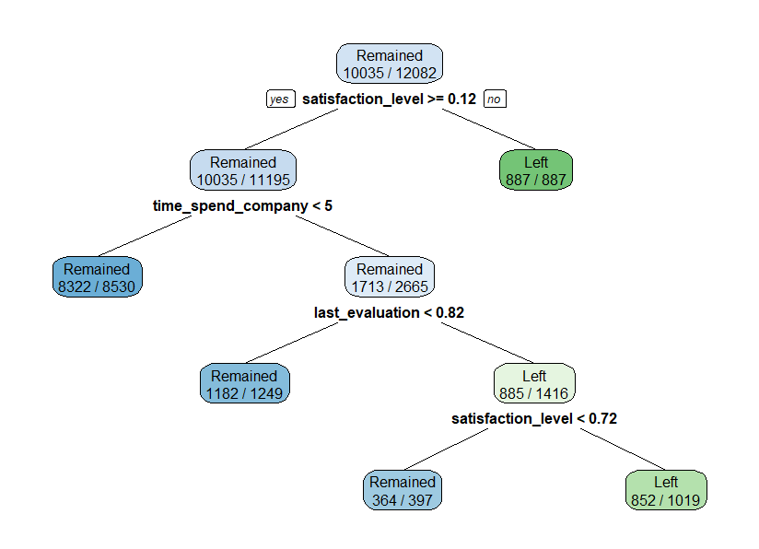
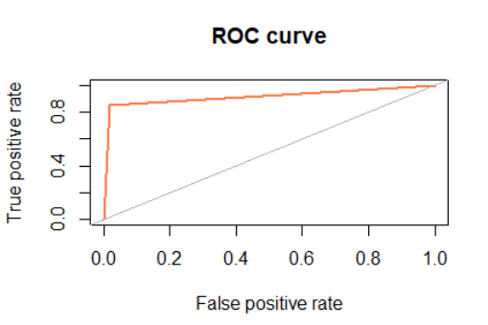
Plotting Trees & ROC Curve
Notes:
The decision tree plot is self explanatory with the leaf nodes showing the predicted outcome.
The area under roc curve clearly shows how accurate our model is.

Slide 17
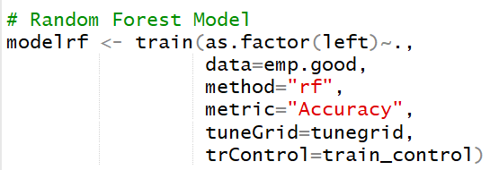
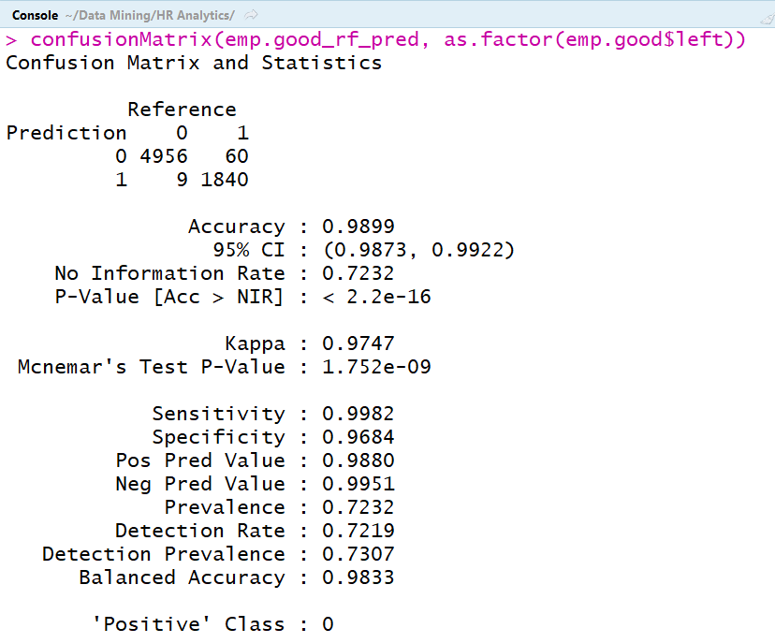
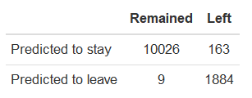
Random Forest
Confusion
Matrix
Training the Model
Predictions
99%
Accuracy
Notes:
RF> TRAIN> Predicted TP and FP. There are 4956 cases which were correctly predicted who stayed, while 1840 cases were correctly predicted to left. From the confusion matrix we can see that this model has 99% accuracy.

Slide 18


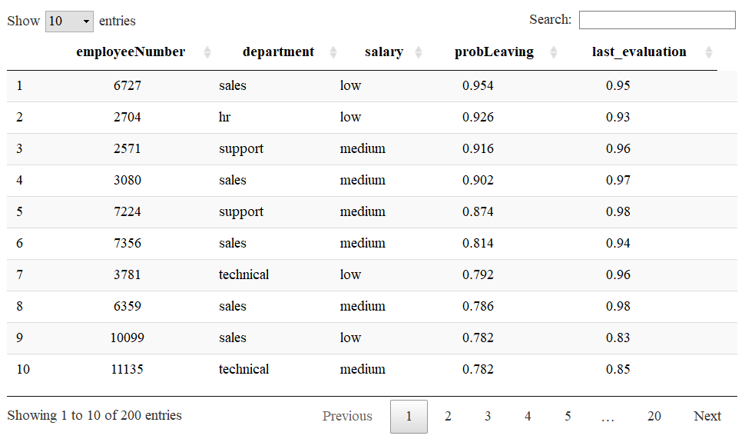
Random Forest Deployment
Notes:
As accuracy of RF is high we choose to Random forest model for deployment.
We created HTML widget in R using data table function which will show top 200 employees in descending order of their prob to leave company.

Slide 19
Take Home...
Pros:
Data Mining on HR datasets will help data driven decision making
We can identify employee sentiments, and explore how results of EDA and Data Mining Algorithm turn into actionable Key Performance Indicators (KPI) for Human Resource Management
Cons:
According to recent survey, HR do not want the model to make decisions instead they want a model which can assist them in decision making process for retaining good employees having higher probability-to-leave

Slide 20


The Team
Aakash Sarap
Sushmita Jadhav
Master’s Degree in Analytics Northeastern University
Master’s Degree in Analytics Northeastern University

